Slide 1
APUSH Review: Native Americans In The Late 19th Century
Everything You Need To Know About Native Americans In The Late 19th Century To Succeed In APUSH

Slide 2
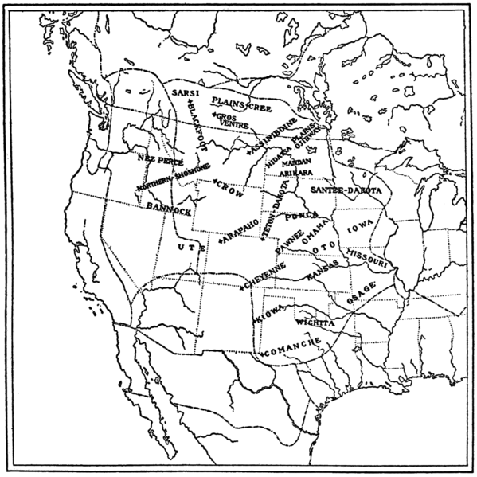
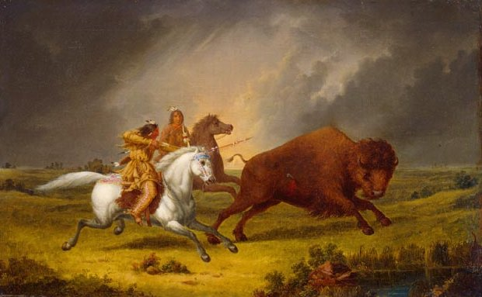
Relocation of Natives
Beginning in the 1830s, Natives were pushed further and further west
Indian Removal Act, Trail of Tears
Plains Indians:
Predominantly hunted buffalo
Land and lifestyle was changed due to expansion

Slide 3
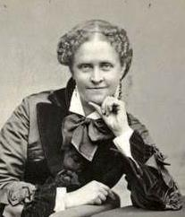
A Century of Dishonor (1881)
Written by Helen Hunt Jackson
Discussed the relationship between the US government and Native Americans
Demonstrated that the Natives were harshly treated and often deceived by the government

Slide 4
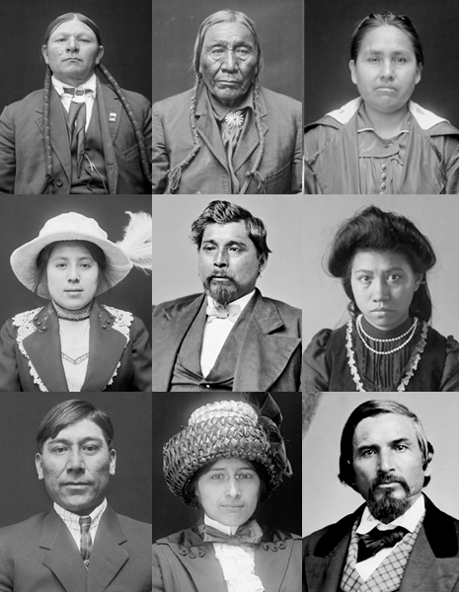
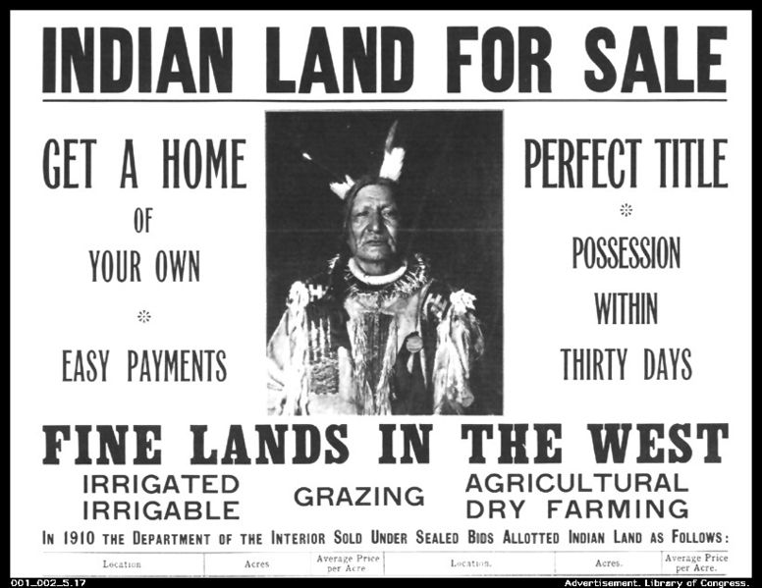
***The Dawes Act*** (1887)
Purpose of the Act:
The goal was to assimilate Native Americans
Make them “Americans” and eliminate Native Culture
Provisions of the Act:
Native tribes were dissolved
Heads of families would receive 160 acres of land
Impact:
Many Native children sent to boarding schools
Native Americans’ lives were changed – hunting to farming
Most of Natives’ land was lost

Slide 5
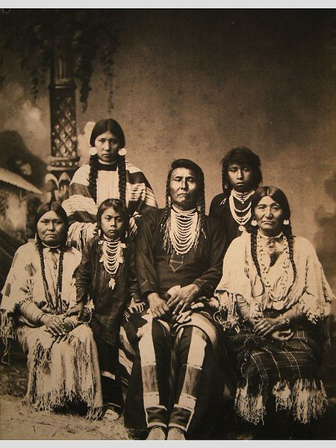
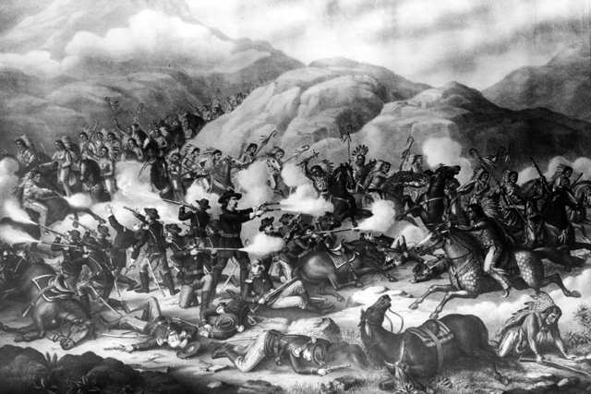
Native American Conflicts
Sioux Wars:
Series of wars throughout the second half of the 19th century
Battle of Little Big Horn (Custer’s Last Stand): (1876)
Custer and his men were killed
Nez Perce War
Chief Joseph and the Nez Perce try to flee to Canada
Caught just before reaching the border

Slide 6
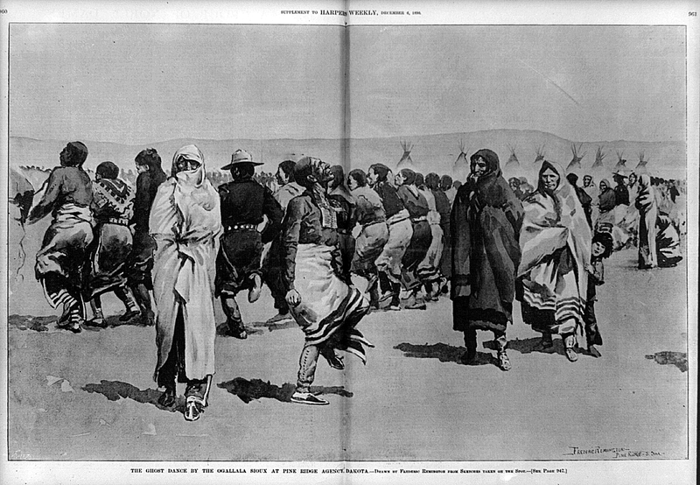
The Ghost Dance
What was it?
Religious movement by Native Americans
Hoped to see the return of buffalo and elimination of whites
Many Americans were afraid of the dance
US government orders an end to it
This leads to…..

Slide 7
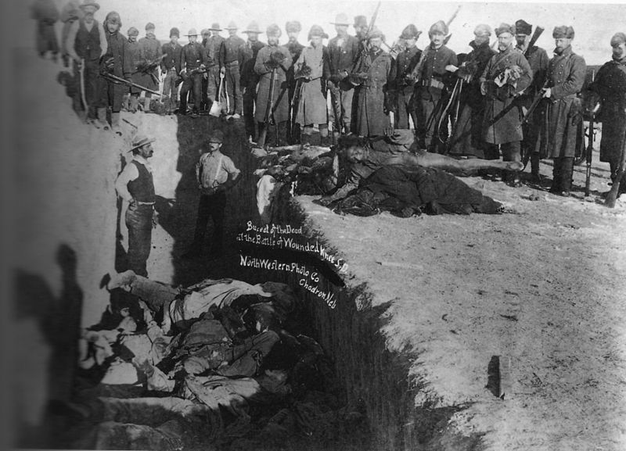
Wounded Knee
One of the final conflicts between American soldiers and Natives
US military wanted to stop the Ghost Dance
About 300 Natives were killed
Many were women and children

Slide 8
Thanks for watching!
Subscribe to my channel
Help spread the word
Questions? Comments? Ideas for videos?
Leave in comments
Subscribe
Down here!

